Slide 1
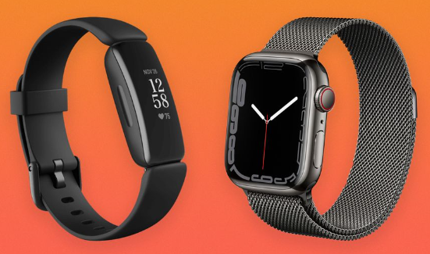
Fitness Trackers and Smartwatches

Slide 2
Data Analysts:
Azriel Manual Tamayo
Debra Mcnulty
Kelly Doyle
Robert Bellgraph

Slide 3
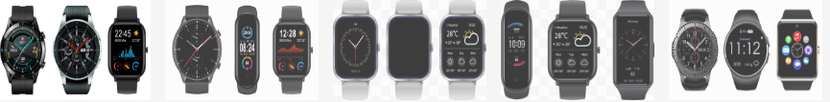







What we did with the data – Data Wrangling
Notes:
Research Questions to Answer:

Slide 4
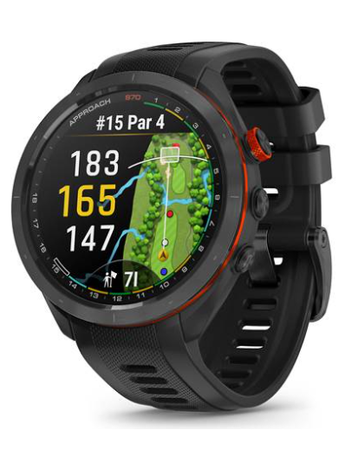
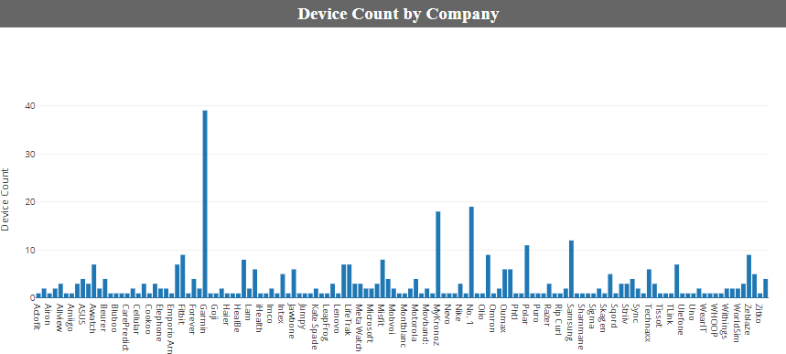
Device Count by Company
Based on chart, we can see the top businesses, Garmin leading with 39 devices in this given time
Apple didn’t come in until 2014-2016
Filter data by each company
No. 1 was actually number 2….
Notes:
Research Questions to Answer:

Slide 5
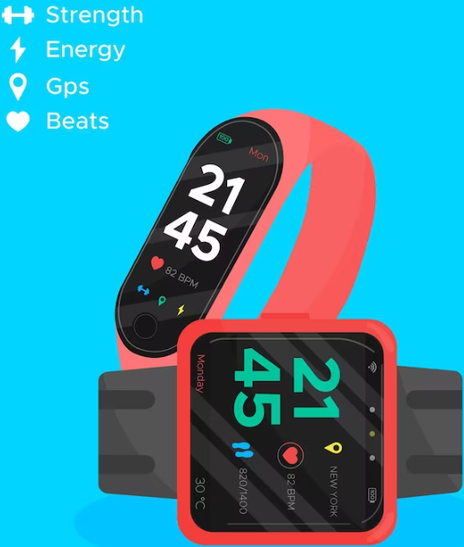
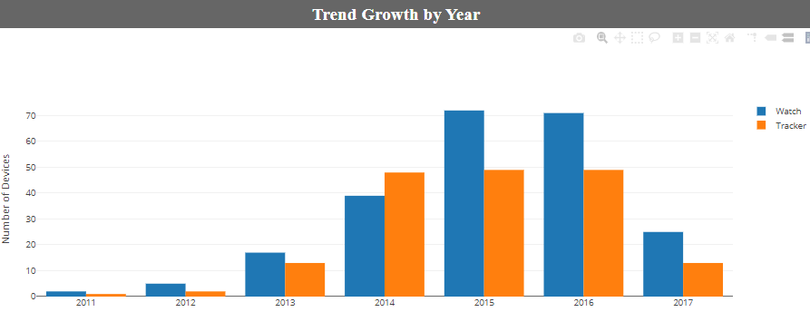
Trend Growth By Year
2013 started to grow
2014 made things popular
2015-16 was the peak
2017 only recorded half of the year
Watches dominated 2015-16
Notes:
Research Questions to Answer:

Slide 6
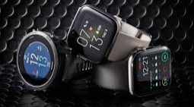
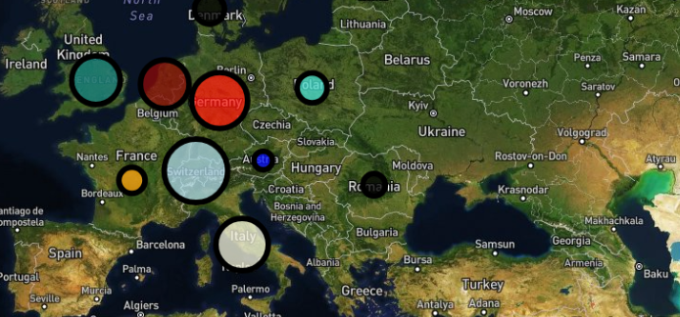
Global wearables map
What did we learn for this Data?
US dominated by nearly double the 2nd highest device producing country.
US almost evenly split between tracker devices and watches. Other countries have a much larger ratio of one to the other.
Asia-Pacific Region was heavier on the watch devices than the trackers.
Asia-Pacific has more watch devices developed than US, despite the US lead in tracking devices total
What do we wish to learn more from this Data?
Have more time to see the options on each device
Find out what options are highest production
Find other options offered since 2017
See where the trend lies now in 2023 and how COVID affect both production, sales and options for 2020-21

